Slide 1
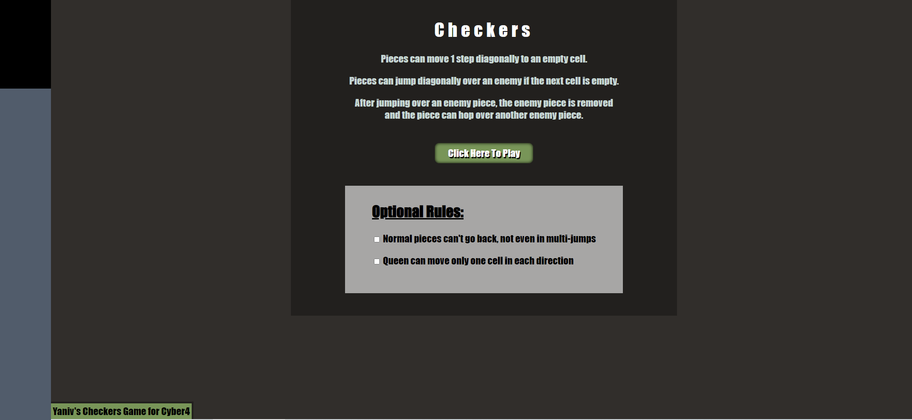
Header
<a onclick="initializeGame()“></a>
<input type="checkbox" id="comboCantGoBack" name="comboCantGoBack" />
<input type="checkbox" id= "queenOnlyOneMove" name="queenOnlyOneMove“ />

Slide 2
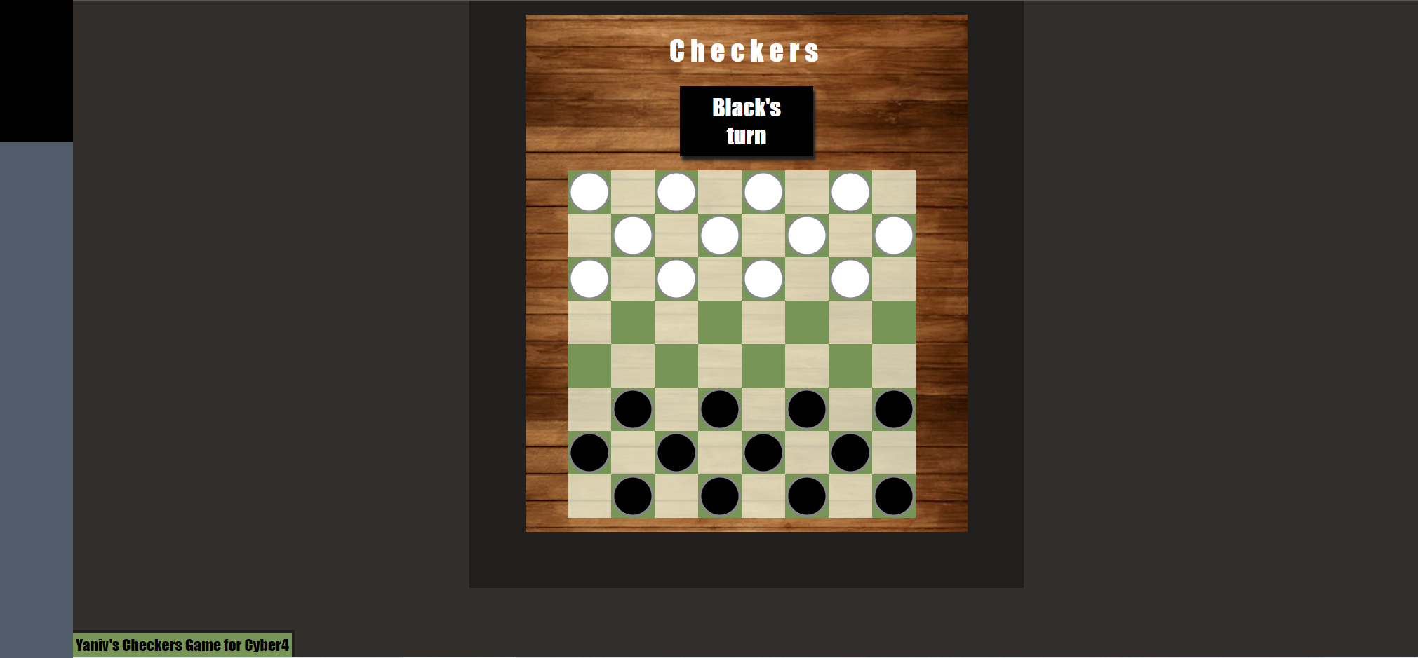
<div id="gameBoard">
<h2 id="turn-h" class="black-turn">
<table></table> Element
Function paintBoard() tdElement.classList.add('dark-cell');
Function paintBoard() tdElement.classList.add('white-piece');

Slide 3
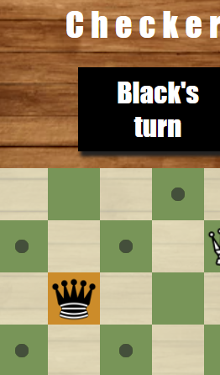
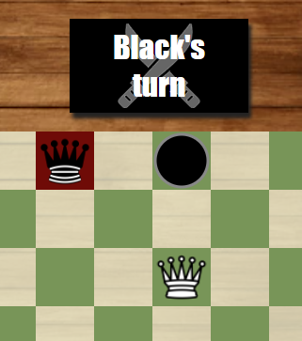
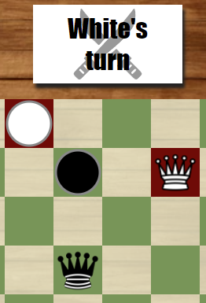
Swords mean one of your pieces can eat
Red background means this piece can eat
getAllOptions( ) marks with
class = “option”
If one of your units can eat, function getAllMoves() only finds eat moves
When a cell is clicked: function cellClick( ) Class “selected”
More than one piece can have a red background

Slide 4
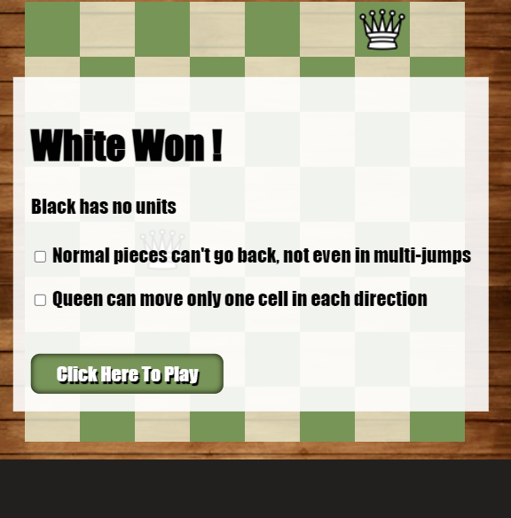
</div id=“white-win”
<input type="checkbox" id="comboCantGoBack2" name="comboCantGoBack2" />
<p id="white-win-condition-text">
Show inputs
<input type="checkbox" id="comboCantGoBack1" name="comboCantGoBack1" />
<a
onclick="initializeGame()“>
</a>
function cellClick() Is disabled

Slide 5
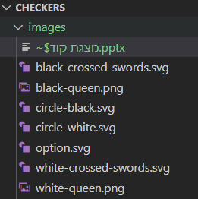
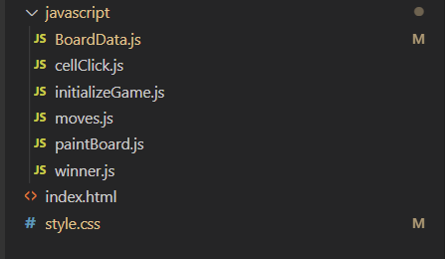
File structure
Class to hold All the game information
Called when I click on the board
Called on “play’ button click. calls boaredData() and paintboard()
Return legalMoves[ ], and mark the board
Creates the table
Called when a player won

Slide 6
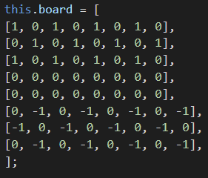
Object data of class BoardData()
data
Board
row[0]
row[…]
row[7]
currentPlayer
Combo
canEat
endGame
settings
Do I have optional moves?
Did I just eat an enemy?
Can any of my units eat an enemy?

Slide 7
CellClick() Clicked on a cell
If the game is on
NO
Do I have something selected?
Select this cell & show it’s moves
Clicked on friendly cell
If it is my piece
YES
What cell was clicked?
Select this cell & show it’s moves
Clicked on empty cell
If unit reached the end
Move the piece
NO
YES
Do Nothing
Is the cell valid move?
Didn’t eat
Did I eat a unit?
To eat means to capture an enemy unit
Did I Win?
Ate a unit
Change player & End turn
Can I eat another?
NO
Did I Win?
YES
Continue the combo
Did I Win?
Change player & End turn

Slide 8
getAllMoves( )
Called possible moves and to check If a unit can eat
legalMoves = [ ]
direction white= 1 / black = -1
Normal piece
What type was clicked?
Queen piece
Add eat forward
Add eat all directions any distance
If I just ate add eat backwards
Can Any of my units eat an enemy?
YES
Can Any of my units eat an enemy?
YES
NO
NO
Add move forward
Add move all directions any distance
Mark cells
Mark cells
return legalMoves
return legalMoves

